Slide 1
Testability in .NET
Jason Bock

Slide 2
Personal Info
http://www.jasonbock.net
https://www.twitter.com/jasonbock
https://www.github.com/jasonbock
jason.r.bock@outlook.com

Slide 3
Downloads
https://github.com/JasonBock/TestabilityInDotNet
https://github.com/JasonBock/Presentations/
blob/master/Testability%20in%20%2CNET.pptx

Slide 4
Overview
Motivation
Benefits
Techniques
Conclusion
Remember…
https://github.com/JasonBock/TestabilityInDotNet
https://github.com/JasonBock/Presentations/
blob/master/Testability%20in%20%2CNET.pptx

Slide 5

Motivation
https://d233tsjqri9sf7.cloudfront.net/files/kanko/353/353--9bc2432e4abfbcc89209f84dc702e124.jpg
Notes:
What we want is something that works as expected, and is tested to last for a long time. That’s where testing comes into play. Making sure you code does what you think it should do makes it easier to maintain as the application changes (as it inevitably will).

Slide 6

Motivation
“Why write unit tests when you write perfect code?!”
Brent Edwards
Notes:
If we lived in the perfect world, we wouldn’t need unit tests. Everything would just work. But the real world isn’t rainbows, hearts and happy faces all the time.

Slide 7



Motivation
public static class Adding
{
public static int Add(int x, int y)
{
return x + y;
}
}
Notes:
Take a look at this innocent code.

Slide 8
Motivation
There’s no interface!
It’s not using generics!
You only take two parameters!
Your naming conventions are horrible!
The performance stinks!
You’re not using Code Contracts!
You forgot about overflows!
You shouldn’t be allowed near a compiler!
Notes:
However, other developers will rip it apart (and sometimes their points aren’t even valid, like the generics one in this list)

Slide 9


Motivation
public static class Adding
{
public static int Add(int x, int y)
{
return x + y;
}
}
Notes:
Now your code looks sad…and it’s in Comic Sans

Slide 10

Motivation
http://www.geniusintelligence.com/4geniuses.jpg
Notes:
We’d like to be geniuses with our code – we always write perfect code with no issues

Slide 11

Motivation
http://www.dvorak.org/blog/wp-content/uploads/2011/01/homer_simpson_brain.jpg
Notes:
But it’s easy for us to do dumb things in code. (Think of the Zune leap year bug)

Slide 12

Motivation
year = ORIGINYEAR; /* = 1980 */
while (days > 365)
{
if (IsLeapYear(year))
{
if (days > 366)
{
days -= 366;
year += 1;
}
}
else
{
days -= 365;
year += 1;
}
}
?
"A bug in the internal clock driver related to the way the device handles a leap year affected Zune users," said the company in a statement. "That being the case, the issue should be resolved over the next 24 hours as the time change moves to January 1, 2009."
http://www.hanselman.com/blog/BackToBasicsExploreTheEdgeCasesOrDateMathWillGetYou.aspx
https://www.wired.com/2008/12/zune-freeze-res/
Notes:
The Zune bug has a problem with leap years. Basically, the days variable will eventually get to 366, but it’ll never break out of the while loop

Slide 13

Motivation
http://celebrating200years.noaa.gov/magazine/tct/01_misaligned_bridge_503.jpg
Notes:
And when we do dumb things in code, we end up with something that just don’t work

Slide 14

Motivation
http://chellem.com/wp-content/uploads/2009/08/stress.jpg
Notes:
And then we end up with frustrated users

Slide 15
Motivation
Time
Maintenance
Legacy code
Perfection
Fear
Notes:
Why don’t we test?
Time – it does take more time to write the tests. However, the benefit is you’ll (hopefully) catch more defects in your code
Maintenance – if we change our code, we might need to change our tests
Legacy Code – it’s too hard to add tests in to our code base. Everything is tied together, and it’s too much effort to put tests into place (“Working Effectively with Legacy Code”)
Perfection – “I write best code” – if code is written exactly to specs, then why write unit tests at all? (ha!)
Fear – “I’ve never done this, how long is it going to take for me to get proficient, etc.”
In the next set of slides, we’ll cover these issues

Slide 16
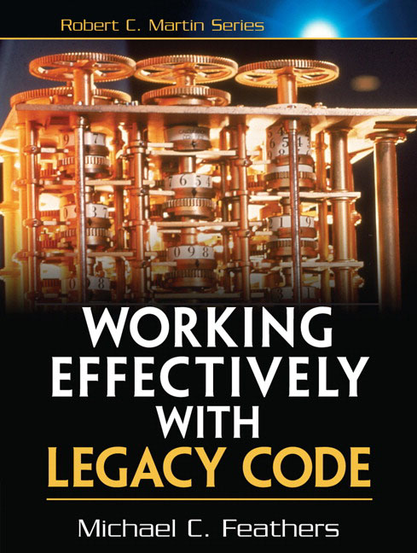
Motivation
“Legacy code is simply code without tests.” –xvi
http://www.informit.com/store/working-effectively-with-legacy-code-9780131177055
Notes:
So why should you test? You don’t want legacy code.

Slide 17
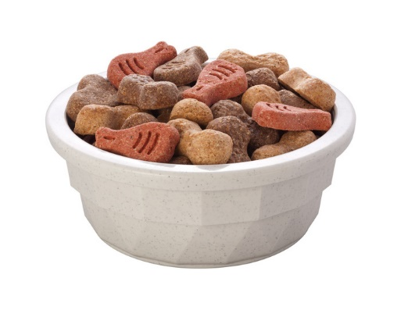
Benefits
http://petsinyourhome.com/wp-content/uploads/Dry-Dog-Food.jpg
Notes:
Unit testing makes developers dogfood their code. Sometimes that interaction with the API is quite revealing.

Slide 18
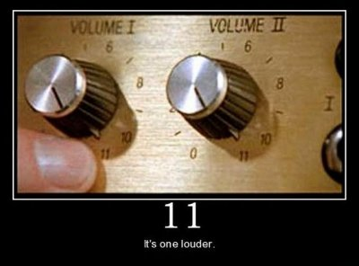
Benefits
http://1.bp.blogspot.com/-tmD37mWtD4Y/TZZYIEhZ7vI/AAAAAAAADLk/SME57WuOfI8/s1600/volume11.jpg
Notes:
Developers also want immediate feedback. Turning up to 11 helps in finding problem spots.

Slide 19
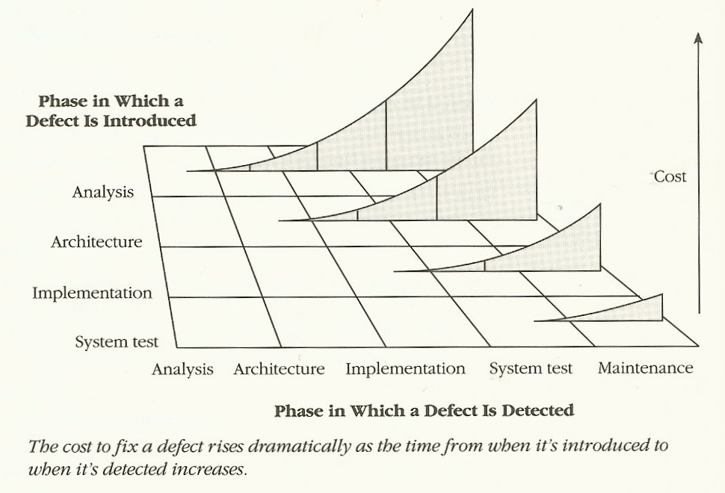
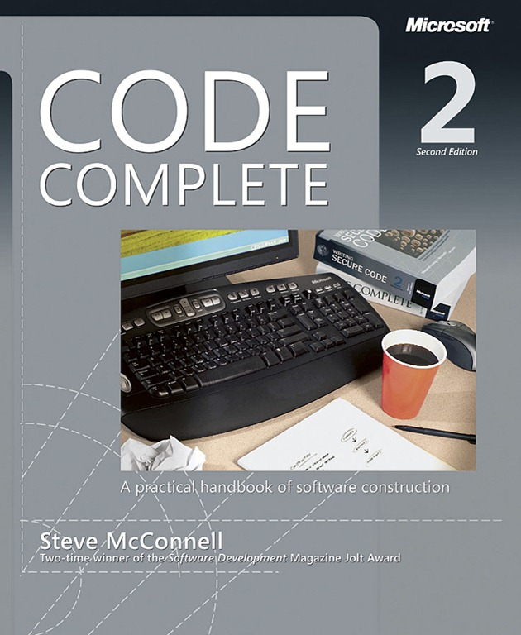
Benefits
http://1.bp.blogspot.com/-tmD37mWtD4Y/TZZYIEhZ7vI/AAAAAAAADLk/SME57WuOfI8/s1600/volume11.jpg
Notes:
“Fail fast” – the sooner you fail, the better off you are. “1 hand clapping” vs. thunderous applause

Slide 20

Benefits
https://d2k9njawademcf.cloudfront.net/indeximages/3794/original/Chocolate_cake_-_for_posting.jpg?1380054214
Notes:
We need clear separations with our layers to make it easier to test our code, no matter how many layers we have

Slide 21
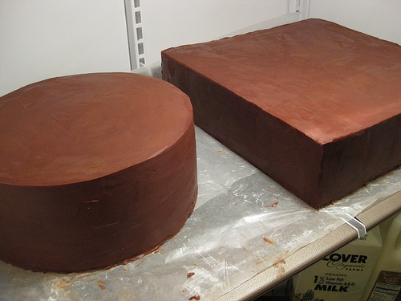
Benefits
http://scratch.typepad.com/.a/6a00e551da83098833012875abba3b970c-800wi
Notes:
A big block of chocolate may be tasty, but that’s not what we want in code, because we can’t easily unit test it

Slide 22
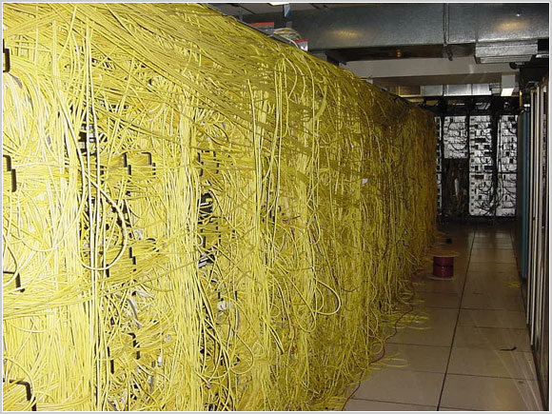
Benefits
http://www.justcabling.com/images/badcable15.jpg
Notes:
We don’t want a huge mess of interactivity within our application layers. It becomes too hard to test and maintain.

Slide 23
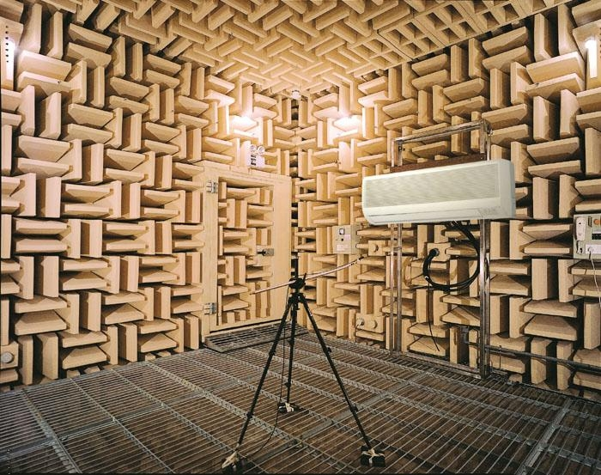
Benefits
http://img.diytrade.com/cdimg/1425754/20255693/0/1302060158/Sound_testing_system.jpg
Notes:
Code in isolation, like a sound room. Removing noise helps you focus on the code under test.
“According to Guinness World Records, 2005, Orfield Laboratory's NIST certified Eckel Industries-designed anechoic chamber is "The quietest place on earth" measured at −9.4 dBA.” http://en.wikipedia.org/wiki/Anechoic_chamber

Slide 24
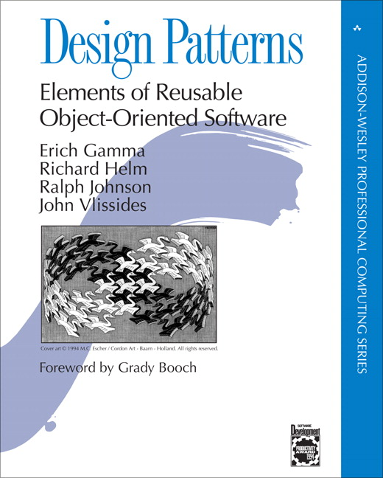
Benefits
“Program to an interface, not an implementation” –pg. 18
https://www.pearson.com/us/higher-education/program/Gamma-Design-Patterns-Elements-of-Reusable-Object-Oriented-Software/PGM14333.html
Notes:
One of the best quotes in Design Patterns

Slide 25
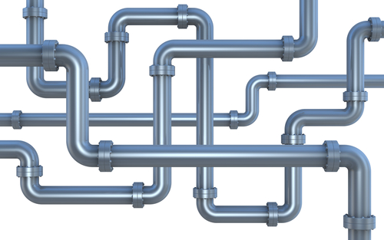
Benefits
http://www.bobsplumbingvideos.com/wp-content/uploads/2013/12/shutterstock_76666990.jpg
Notes:
This can also help if you run tests in parallel. By isolating tests and getting rid of shared state, you can run tests in parallel and not worry about inconsistent failed tests.

Slide 26
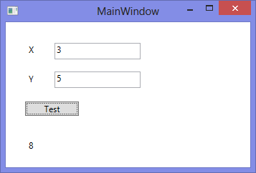
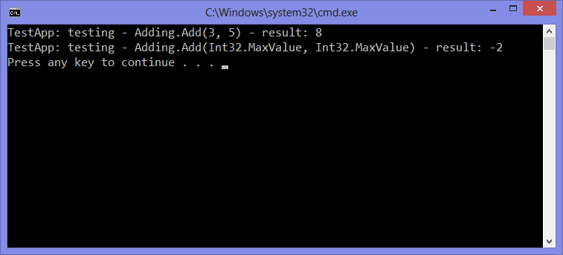
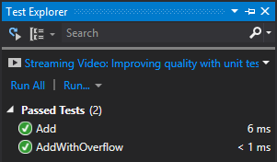
Benefits
Notes:
You’ll always want to do end-to-end testing as a developer, but that’s not easily repeatable. Writing apps that test code in a repeatable fashion is a better approach. Using a framework to easily run tests locally and on a build server is the way to go.

Slide 27
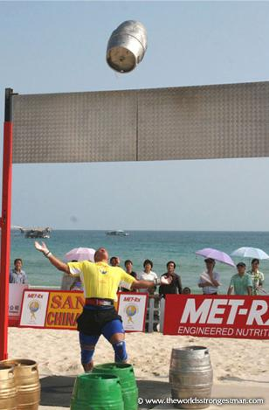
Benefits
http://www.theworldsstrongestman.com/wp-content/uploads/2011/07/Keg1.jpg
Notes:
Throwing it over the wall to QA is not a good idea either.

Slide 28
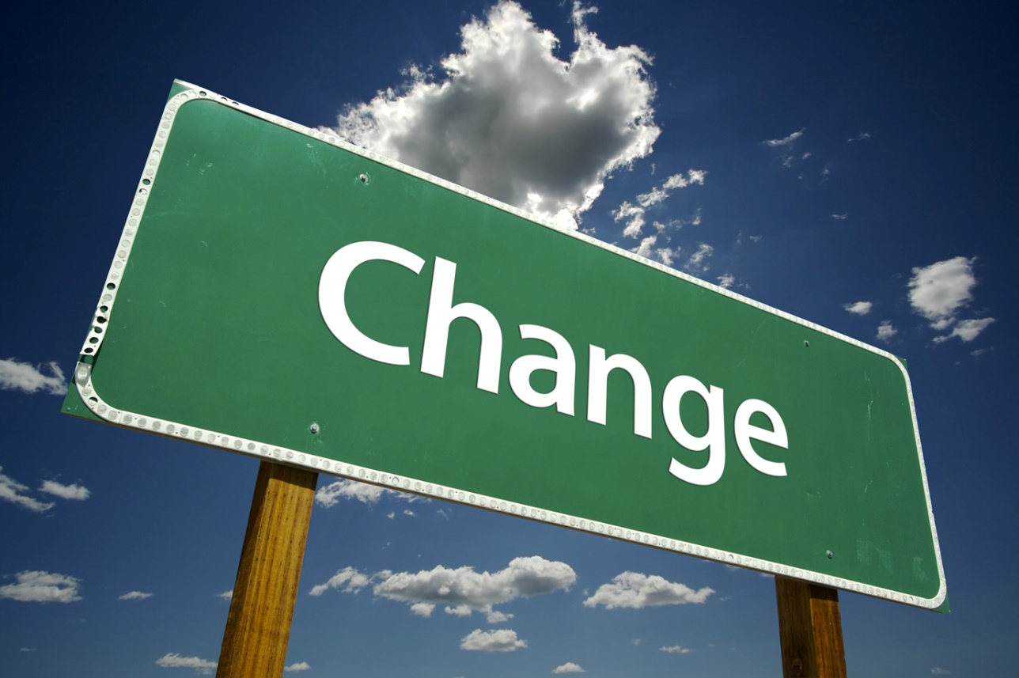
Benefits
http://jmanandmillerbug.com/wp-content/uploads/2012/02/change.jpg
Notes:
And having tests that run automatically helps with change. Change is inevitable in code. Virtually all the applications I’ve coded on that have had any life to them will go through change. Features will be added, bugs will be fixed, UIs will be altered – it happens. As developers, to have any hope of assurance that things work as expected is to have a suite of tests that I can fire off and inform me where things are at.

Slide 29
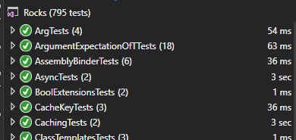
Benefits
https://github.com/jasonbock/rocks
Notes:
Here’s my own experience. My Rocks library has a fair amount of tests.

Slide 30
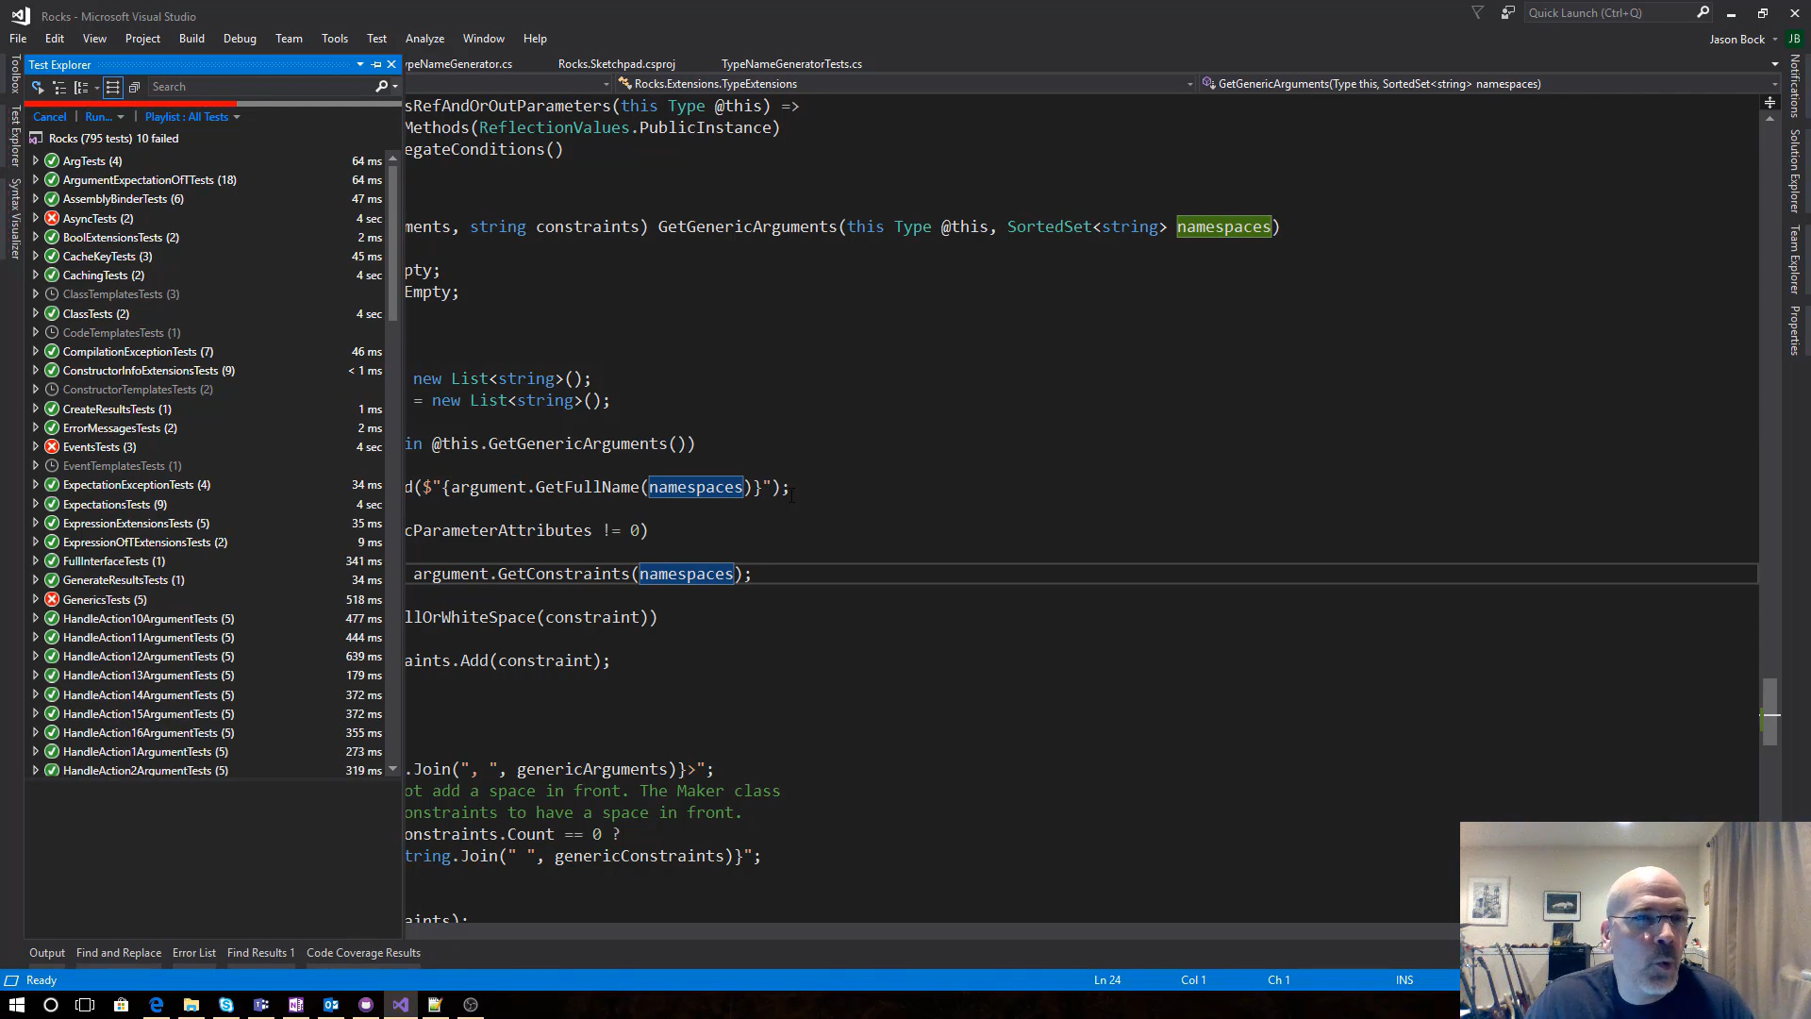
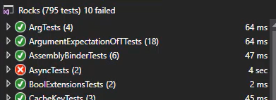
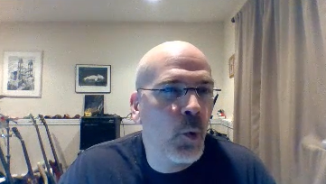
Benefits
https://youtu.be/XJw-E2QQr-I?t=1581
Notes:
I’m doing some live coding, and one time I made a change and unexpectedly broke tests. You can see my “oh crap!” face show up!

Slide 31
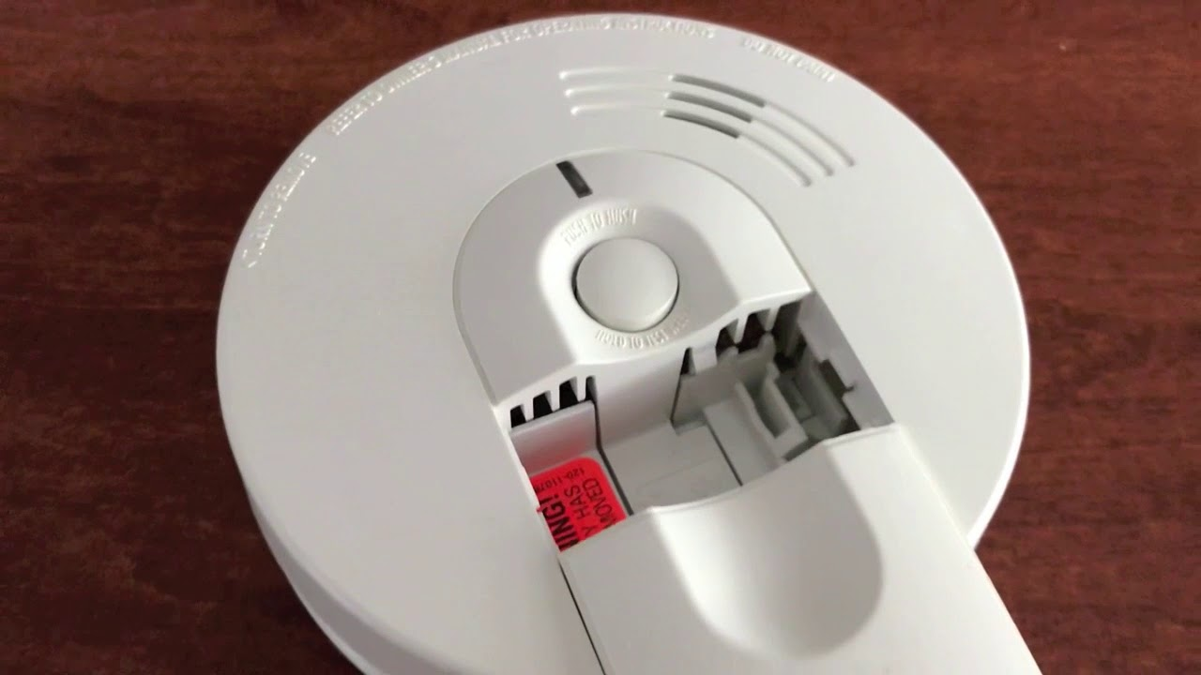
Benefits
https://i.ytimg.com/vi/FakT1rgcmrw/maxresdefault.jpg
https://twitter.com/pottereric/status/1172146329105162240
Notes:
Having this coverage against change is crucial, which is why you shouldn’t delete tests that are failing.
"Commenting out unit tests is the software equivalent of taking the batteries out of a smoke detector." - https://twitter.com/pottereric/status/1172146329105162240

Slide 32
Testing
TDD, BDD, *DD, etc.
Notes:
Many different techniques and ideas exist for unit testing, and they all have something to bring to the table

Slide 33
Testing
AAA: Arrange, Act, Assert
Notes:
AAA: good approach to structuring unit testing code

Slide 34
Testing
MSTest
NUnit
xUnit
Fixie
Notes:
Here’s a list of unit testing libraries

Slide 35
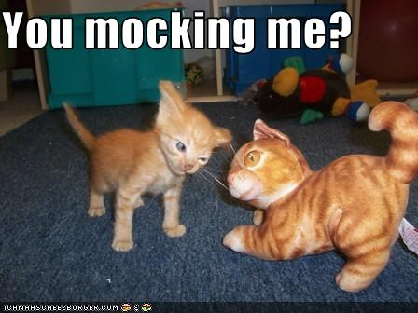
Testing
http://bit.ly/12NjkUn
Notes:
Using mocking libraries help in isolating code under test

Slide 36
Testing
Person
PersonRepository
Notes:
Here’s how it works. Let’s say Person has a reference to PersonRepository. This is strong coupling and can make testing difficult.

Slide 37
Testing
IPersonRepository
Person
PersonRepository
Notes:
The way to fix this is to create an abstraction that Person references and PersonRepository implements. Then an instance of PersonRepository is injected to Person.

Slide 38
Testing
IPersonRepository
Person
PersonRepositoryMock
Notes:
In a test, you can create a mock of PersonRespository, either by hand or using a framework, that has a specific setup that you can verify in a test that it was used correctly.

Slide 39
Testing
Moq
NSubstitute
Rocks
FakeItEasy
Notes:
And here’s some mocking libraries

Slide 40

Testing
https://news.leavitt.com/wp-content/uploads/2011/07/Green-umbrella.jpg
Notes:
Code coverage is a good metric to use as long as you understand what it’s measuring. It simply informs you of code that hasn’t been executed during a test. It’s not a measure of test quality.

Slide 41

Testing
https://origin.pymnts.com/wp-content/uploads/2014/09/numbers2.jpg
Notes:
Also….”how many tests should we have?” gets asked too. It’s really not about many you have, it’s about how effective they are. That said, in general, the more code you have, the “more” tests you should have as well, but IMO there is no hard and fast rule.

Slide 42
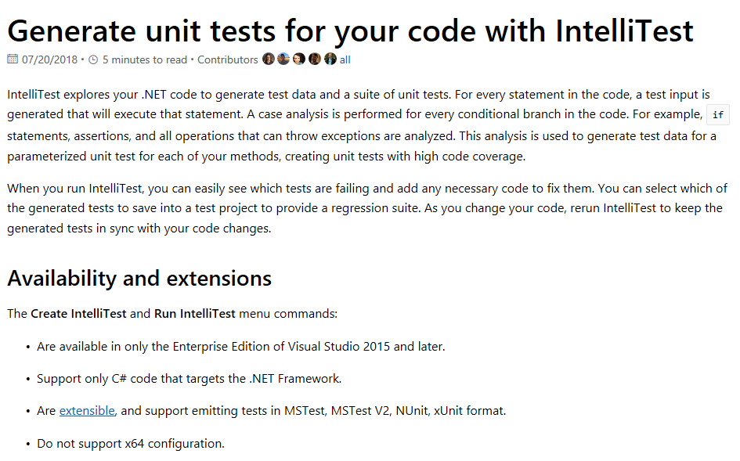
Testing
https://docs.microsoft.com/en-us/visualstudio/test/generate-unit-tests-for-your-code-with-intellitest?view=vs-2017
Notes:
Code coverage is a good metric to use as long as you understand what it’s measuring. It simply informs you of code that hasn’t been executed during a test. It’s not a measure of test quality.

Slide 43
Demo: Writing Tests in .NET
Testability in .NET

Slide 44


Conclusion
http://snowbrains.com/wp-content/uploads/2013/04/mount-everest.jpg
http://worldwide.streamer.espeakers.com/assets/9/9179/30001.jpg
Notes:
Making code maintainable is an investment in time (and money). It may seem daunting, especially if you haven’t used the techniques and tools used in the presentation. But if you’re willing to invest, your application will be looking down at the others!

Slide 45
Testability in .NET
Jason Bock
Remember…
https://github.com/JasonBock/TestabilityInDotNet
https://github.com/JasonBock/Presentations/blob/master/Testability%20in%20%2CNET.pptx
References in the notes on this slide
Notes:
References
* Guidelines for Better Unit Tests - https://www.infoq.com/news/2009/07/Better-Unit-Tests
* Test Experience Improvements - https://blogs.msdn.microsoft.com/visualstudio/2017/11/16/test-experience-improvements/
* Should Code Review Include Manual Testing? Depends! - https://exceptionnotfound.net/should-code-review-include-manual-testing-depends-2/
* Unit Testing: Basics and Best Practices - https://www.daedtech.com/unit-testing-basics-best-practices/
* How Much Unit Testing is Enough? - https://www.daedtech.com/unit-testing-enough/
* Common Excuses Why Developers Don’t Test Their Software - https://hackernoon.com/common-excuses-why-developers-dont-test-their-software-908a465e122c

